Slide 1

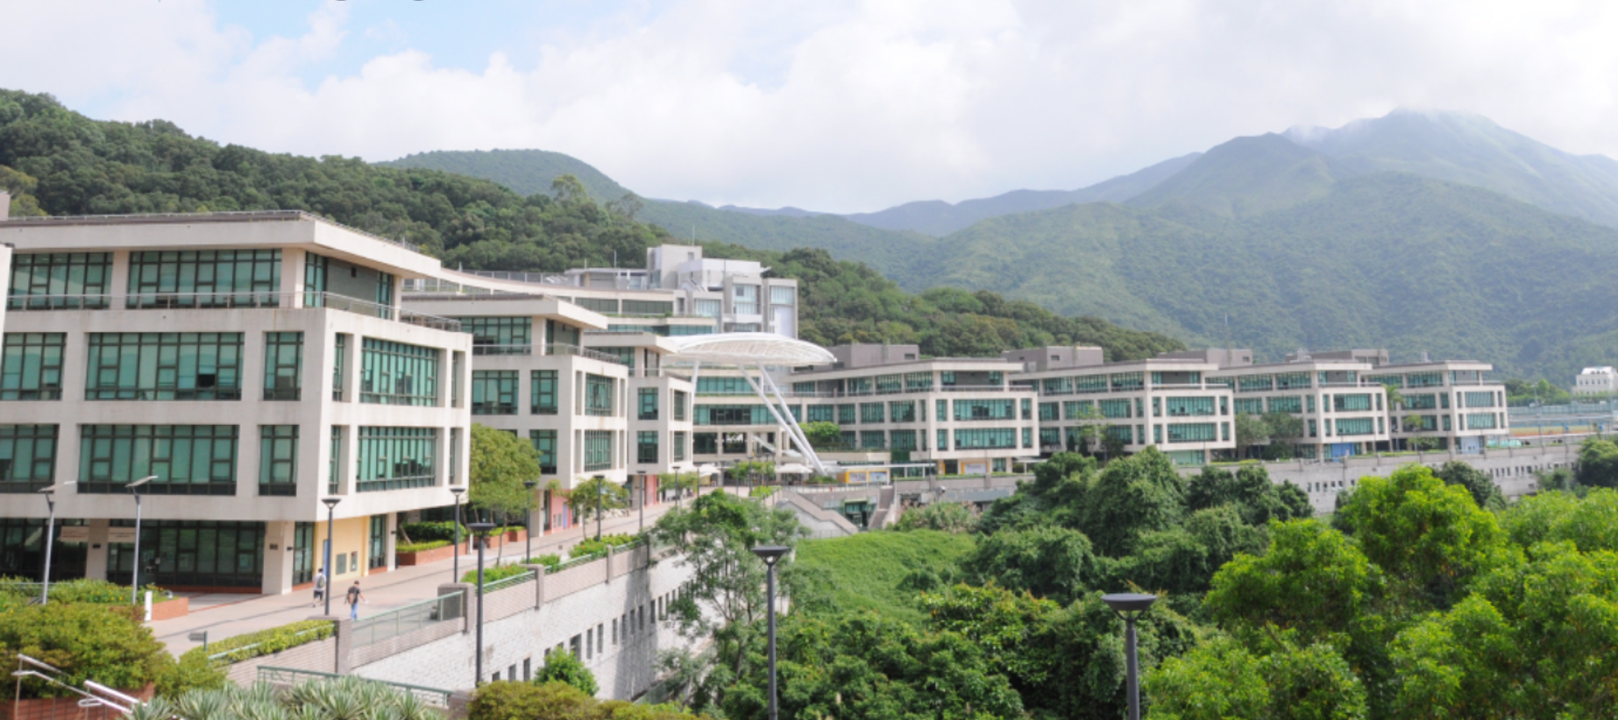
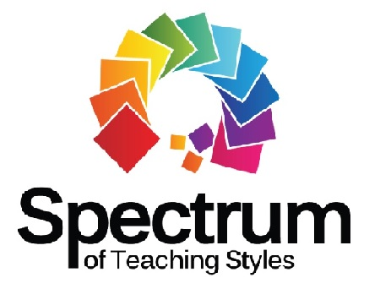

The development of Spectrum of Teaching Styles in Hong Kong
KAM, Wai Keung Kevin
28 March 2022

Slide 2








What has the Spectrum Developed in Hong Kong? An overview
Spectrum has been included in the pedagogical course in PETE Programme since 90s.
Topics with Spectrum in Honor Project from PETE programme and Action Research from In-service Teachers presented in local PE teachers conference
Dr. LI, Chung; Dr. CRUZ, Alberto and Mr. KAM, Kevin from the Education University of Hong Kong worked together to promote model-based pedagogies in PE in Hong Kong
Dr Sara ASHWORTH had been invited to deliver her keynote speech on Spectrum regarding to develop students’ generic skills through PE in 2018
In 2010, Dr. LI, Chung led a group of local school PE teachers participated and presented their work with Spectrum in International Conference on Mosston's Spectrum of Teaching Styles sponsored by the Taiwan Society for Sport Pedagogy held at National Taiwan Normal University, Taipei, Taiwan.
A pilot study on using reciprocal style of teaching in Hong Kong in 2011
https://web.s.ebscohost.com/ehost/pdfviewer/pdfviewer?vid=0&sid=e664ae57-965b-4962-9113-9a1652c64b83%40redis
A comprehensive reference text, Research and Promotion of Mosston’s Spectrum of Teaching Styles in Hong Kong, had been published in 2013
http://libdr1.eduhk.hk/imgdata/arch00/link/archive/1/instarh/3639_image.pdf
Professional sharing on the Spectrum in Education Bureau, Principal Associations, HK Police Academy and received positive and encouraging feedbacks.

Slide 3
World wide education reform movement followed by Hong Kong at the late 20thC
Social changes
Technological advancement
Challenges on Education
Local Economical Changes
  Demand for democracy
  Equality, equity
  Right to participate
  Right to know
  Right to decide
  Depression
  Less job opportunity
  Changing jobs
  Contract terms
  Uncertainty
  Globalization
  Knowledge explosion, ownership and acquisition
Education Reform in Hong Kong
Notes:
The education reform started from the 20th century followed with the worldwide education reform movement. The local economical changes, social changes and technological advancement put together some challenges on education and lead to education reform in hong Kong.

Slide 4
Education Reform
Self-motivated, committed and innovative life-long learners
Sustained competitors
Education for tomorrow
(Education Manpower Bureau, 1999)
Notes:
Based on the education for tomorrow, the students are expected to be a sustained competitors by developing them into a self-motivated, committed and innovative life-long learner.

Slide 5
Ongoing Renewal of the School Curriculum
Further update on the 15-year central school curriculum framework in 2017 and used the term "Learning to Learn 2.0" to denote curriculum development had advanced with times since the Learning to Learn Curriculum Reform in 2001.
The Major renewed emphases (MRE) include:
  strengthening values education (including moral and civic education, and Basic Law education)
  reinforcing the learning of Chinese history and Chinese culture
  extending "Reading to Learn" to "Language across the Curriculum"
  promoting STEM education and ITE
  fostering an entrepreneurial spirit
  diversifying life-wide learning experiences (including those for VPET)
  stepping up gifted education
  enhancing the learning and teaching of Chinese as a second language
(Curriculum Development Council, 2017)

Slide 6
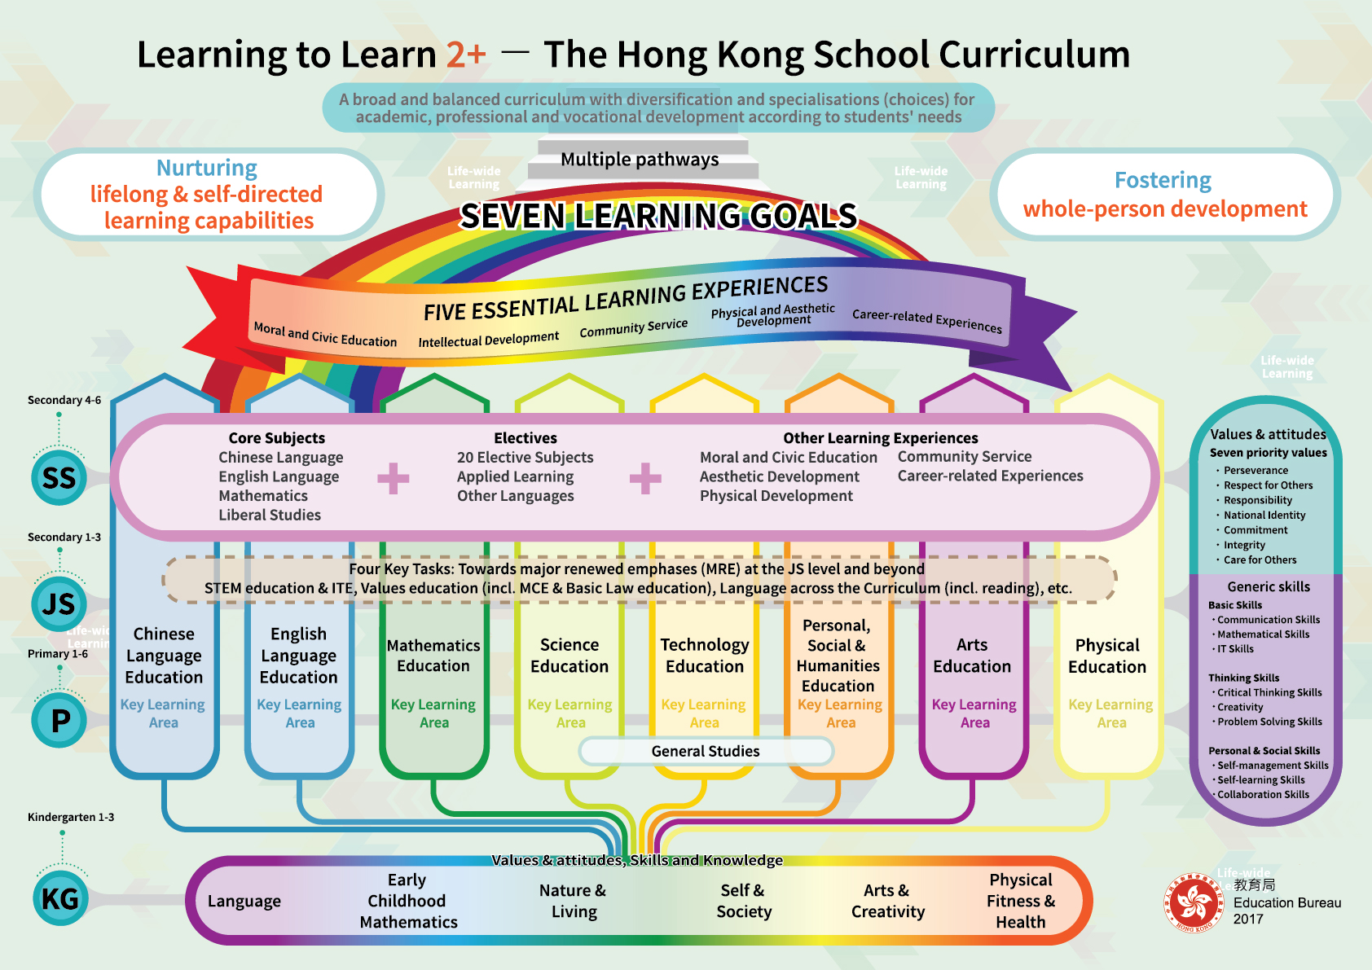

Slide 7
Limitation of Curricular and Pedagogical Practices of PE in Hong Kong
Popular curricular model- “the multi-activity” model with “education through physical” orientation
Dominated pedagogical practice-direct teaching with command style
Limited to physical, motor and sports skill enrichment for students

Slide 8
Implications on the concepts of knowledge, learning & teaching
Reconceptualization of beliefs and assumptions of nature of knowledge, learning and teaching
The uncertainty and unpredictability
  evaluation of learning and teaching in schools in Hong Kong
Supplementing behavioral with Constructivist view of learning
  student-centered
  active learning
  learning-to-learn
  life-wide learning
  life-long learning
(Education Commission, 1999)
(Education Commission, 2000)
(Curriculum Development Council, 2017)
Notes:
Hence, there’s reconceptulization of beliefs and assumptions of nature of knowledge, learning and teaching. The uncertainty and unpredictability lead to a need on evaluation of learning and teaching in schools in Hong Kong. Supplementing behavimay lead

Slide 10
9 Generic Skills learning to learn skills

Slide 11

9 priority Values and Attitude for social and moral development
Commitment
Perseverance
National Identity
Empathy
Integrity
Law-abidingness
Responsibility
Respect for Others
Responsibility
Care for others

Slide 12
Change in the Nature of PE Learning
More emphasis on
Social learning
Cognitive Learning
Experiential
- learning by doing
Others

Slide 13
PE Teachers are urged to enhance the quality of teaching and learning through:
Implementing effective curriculum and pedagogical initiatives
Promotion of pedagogical and curricular innovations as one of the initiatives in HPE
Providing alternatives
Promoting students’ learning towards the goals of “learning to learn” and “all-round development”
Strengthening relevant elements of learning

Slide 14
Vision and Mission of HPE, EdUHK
…lead physical education (PE), health education, and sports science education locally, regionally, and ultimately internationally with a focus on educational research, development, and innovation. We will continue to nurture outstanding and caring educators and professionals to have a sustained impact on social progress and human betterment in Hong Kong and beyond.
provides teacher education and education-plus programmes to fulfil the following objectives:
  Nurturing quality PE teachers as well as sports and health professionals who are self-reliant life-long learners capable of integrating theory and practice to serve as role models and encourage personal and professional healthy behaviours; and
  Innovatively and strategically enhancing the department’s leading role in the field.
  Collaborating with PE Teachers in practice reference research
  Building a knowledge based PE teaching and curriculum

Slide 15
Bachelor of Education (Honours) (Physical Education)
Domain | Credit Points (cps)
Major (including an Interdisciplinary Course) | 39
Education Studies Education Studies Core (Generic) Pedagogy for Major | 30
General Education | 22
Final Year Project (Honours Project / Capstone Project) | 6
Electives (including Free Electives, Minor or Second Major) | 30
Field Experience | 20
Language Enhancement | 9
Total: | 156

Slide 16
Postgraduate Diploma in Education (Secondary) (PGDE)
Domain | Credit Points (cps)
Major Subject Studies – Subject Methods | 6/9
Education Studies | 12
Electives Studies – Core and General | 6/9
Field Experience | 6

Slide 17
Postgraduate Diploma in Education (Primary) (PGDE) - PE
Domain | Credit Points (cps)
Teaching Subject Study 1 – Subject Methods | 3
Teaching Subject Study 2 – Subject Methods | 3
Education Studies | 12
Electives Studies | 9
Field Experience | 6

Slide 18
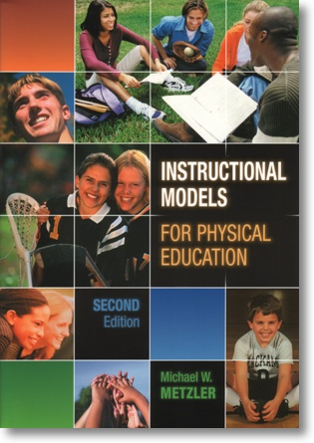
Metzler (2005)
shifting PE teachers’ thinking from methods to models
The Models are theoretical framework with
  underlying educational philosophy
  intentions
  prescribed content
  preferred methods and
  expected learning outcomes

Slide 19
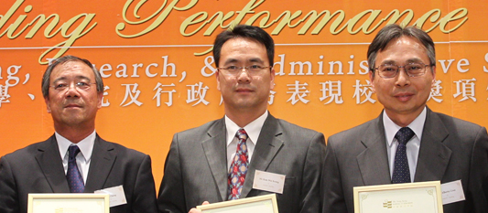
Common Curriculum Models
Motor Skill and Game model
Organized Recess Model
Multi-Activity Model
Fitness Education Model
Spectrum of Teaching Styles
Sport Education Model
Conceptual Based Model
Teaching Games for understanding
Assessment for Learning
Cooperative Learning
A team of colleagues, including Dr. LI, Chung; Dr. CRUZ, Alberto and myself, Incorporating different types of learning for students including social, cognitive and other types of learning experiences

Slide 20
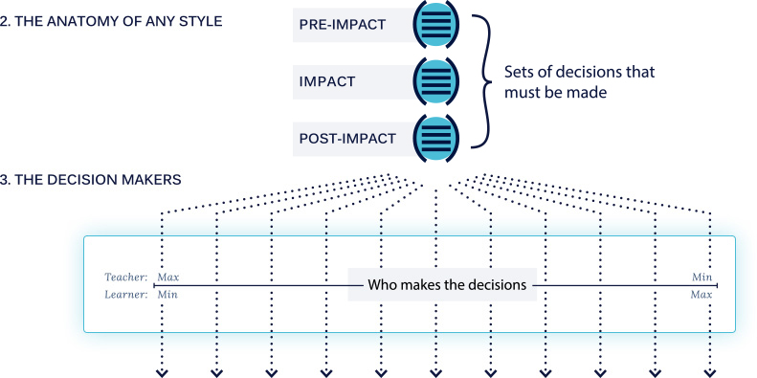
What have been currently researching and practising concerning PE curriculum and pedagogy worldwide?
One of the initiatives- curricular and pedagogical innovations
Mosston’s spectrum of styles (Mosston and Ashworth 2002).

Slide 21

PE Curricular and Pedagogical Innovations
The Spectrum of Styles (11 Teaching Styles)
catering students’ diversity
Promoting students’
Supplementing behavioral with Constructivist view of learning
Linking content to process for conscious thinking – memory, discovery and creativity
Incorporating student-centered learning
Enhancing learning-to-learn
meeting multiple PE Objectives
providing a coherent, comprehensive and integrated framework for teaching and learning
active learning
life-wide learning
life-long learning

Slide 22

The Way Forward

Slide 23
Way Forward
Domain
- Pedagogical development
Community
- Relationships built through conference, lesson for analysis, formal and informal sharings,
Practice
- Use of Spectrum in teaching PE in schools
Inclusion as one of an important teaching tools in PETE
Five-week intensive professional programme, namely New paradigm in teaching and Learning of PE, for PE teachers
Professional development programmes and creating a professional learning community by Hong Kong PE Teachers Conference

Slide 24
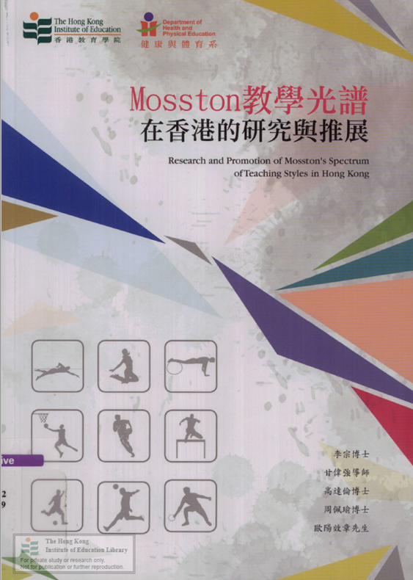
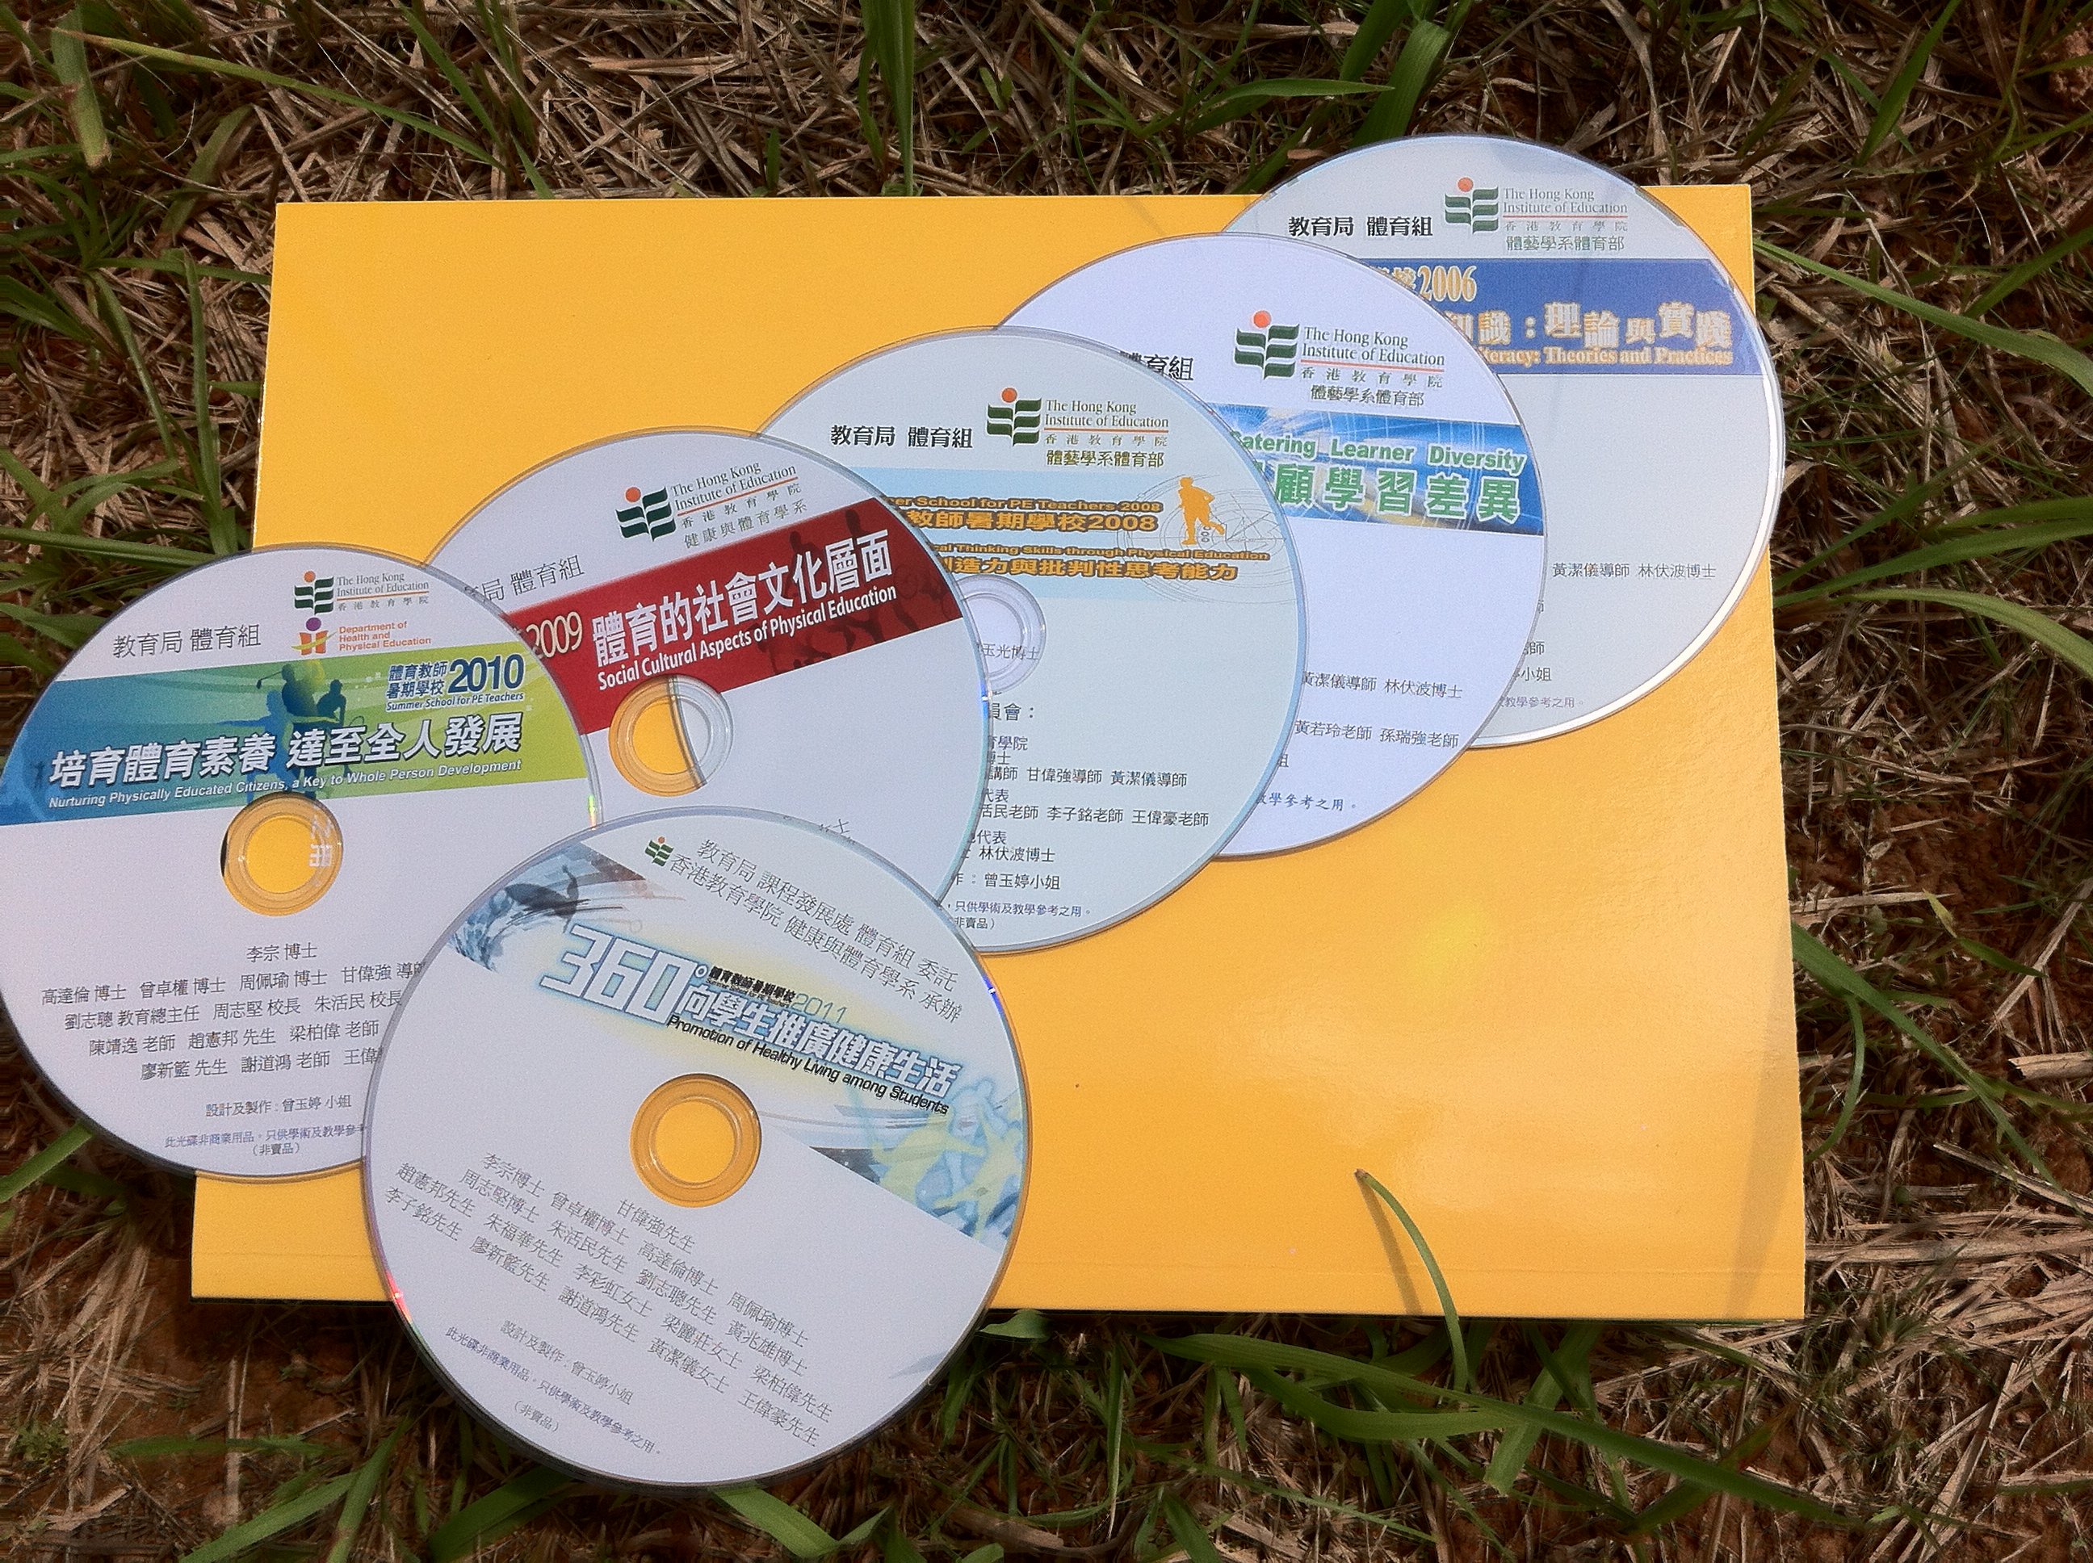
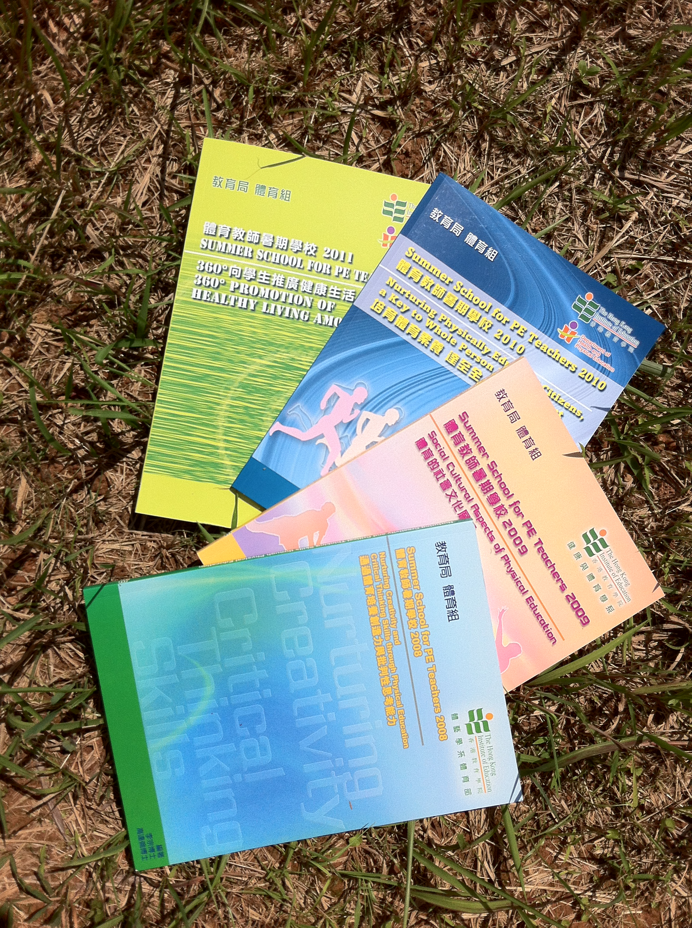
Way Forward
Demonstration lessons for analysis by in-service and pre-service PE teachers
Presentations of the results of collaborative research projects in experience sharing seminars
Chapters and books in Edited Texts
DVDs

Slide 25
Lesson for Analysis Examples – Spectrum of Teaching Styles
Demonstration of Inclusion Style in teaching table tennis for graded 5 students in 2007 by Mr. Lau Ka Chun https://www.eduhk.hk/pesummerschool/Website2007/doc/Pri%20-%20Lesson%20for%20Analysis.pdf
Demonstration of Divergent Thinking and Guide Discovery in teaching Body Manipulative Activities for graded 1 students in 2008 by Ms Wong Ka Lo https://www.eduhk.hk/pesummerschool/Website2008/doc/Pri-LessonforAnalysis.pdf
Demonstration of Reciprocal Teaching Style in teaching passing and support in basketball for graded 5 students in 2010 by Mr. Woo Yat Hei
https://www.eduhk.hk/pesummerschool/Website2010/Doc/SumSchdemLessonPhi2010.pdf
Demonstration of Reciprocal Teaching Style in teaching putting in golf for graded 4 students in 2009 by Mr. Chu Tsz Yat
https://www.eduhk.hk/pesummerschool/Website2009/doc/LessonforAnalysis-Pri.pdf
Demonstration of Guided Discovery in teaching passing in Basketball for graded 9 students in 2018 by Mr. Yim Wai Tak
https://www.eduhk.hk/pesummerschool/Doc/Lesson%20plan_Sec.pdf

Slide 26
Collaboration Action Research Examples with Local PE Teachers
Mr. LAM Ho Yuen & Dr. LI Chung (2009)
Reciprocal teaching style in PE - An experience from Christian Alliance S.Y. Yeh Memorial Primary School
https://www.eduhk.hk/pesummerschool/Website2009/doc/Seminar-P2.5.pdf
Mr. LI Chi Ming & Dr. LI Chung (2009)
Reciprocal teaching style in PE - An experience from Tin Shui Wai Government Secondary School
https://www.eduhk.hk/pesummerschool/Website2009/doc/Seminar-S1.5.pdf
Mr. Wong Tung Ming, Mr. LI Chi Ming and Dr. LI Chung (2010)
Promoting all round development through reciprocal teaching - Experience of Tin Shui Wai Government Secondary School
https://www.eduhk.hk/pesummerschool/Website2010/Doc/S1.4-ExperienceofTinShuiWaiGovtSecSch.pdf
Ms CHU Hoi-ying and Mr. KAM Wai Keung Kevin (2019)
Developing Student's Aesthetic Sensitivity and Active Lifestyle through Applying Blended Learning and Inclusive Style in Teaching Table Tennis
https://www.eduhk.hk/hkpetc/Website2019/Doc/PS3-A.pdf
Mr PAU Sai-yin and Dr. LI Chung (2019)
Promoting Students’ Self-directed Learning through the Application of Mosston’s Self Check Teaching Style
https://www.eduhk.hk/hkpetc/Website2019/Doc/PS8-A.pdf

Slide 27

Kam Wai Keung Kevin
Senior Lecturer, Department of Health and Physical Education (HPE)
Director, School Partnership and Field Experience
The Education University of Hong Kong

